Slide 1
Breadboards and Power
Lecture 1
Ⓒ 2018 ECSESS RoboElectronics Committee, Slides adapted from Dirk Dubois

Slide 2


Who we are?
A club under ECSESS (Electrical, Computer and Software Engineering Student Society)
A club dedicated to teach students who have no experience with robotics or electronics to build a robot of their own.

Slide 3
Your Instructor
Han Zhao
Email : han.y.zhao@mail.mcgill.ca
About myself:
Work on IoT and Cloud technologies
Graduated in Software Engineering
Hobbies
Making stuff : 3D printing, electronics or software
Music
Projects : https://github.com/HanYangZhao
How I got into this workshop
Attended the first iteration in 2012

Slide 4

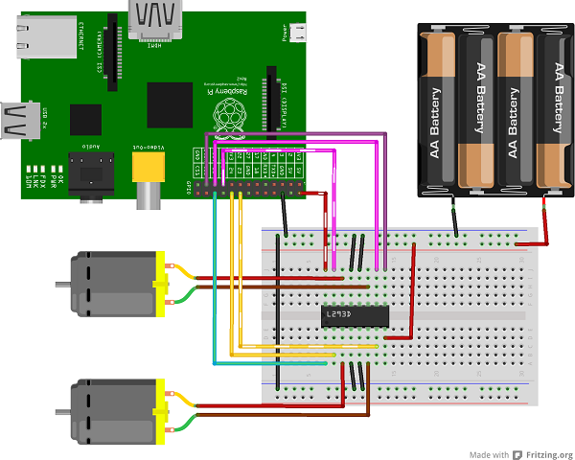
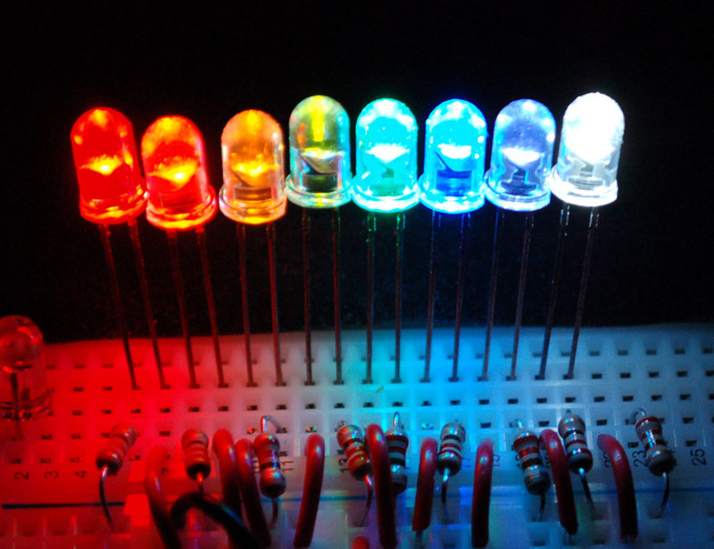
What you’ll learn
Gain basic hands-on electrical and electronics skills
Use breadboards, make prototypes & learn how to use Raspberry Pis
Use discrete components for digital electronics, such as resistors, LEDs, microcontrollers etc.
Programming (Python) and using it to interface with hardware
Understand DC power supplies and voltage regulators.
Understand motor control using H-bridges.

Slide 5
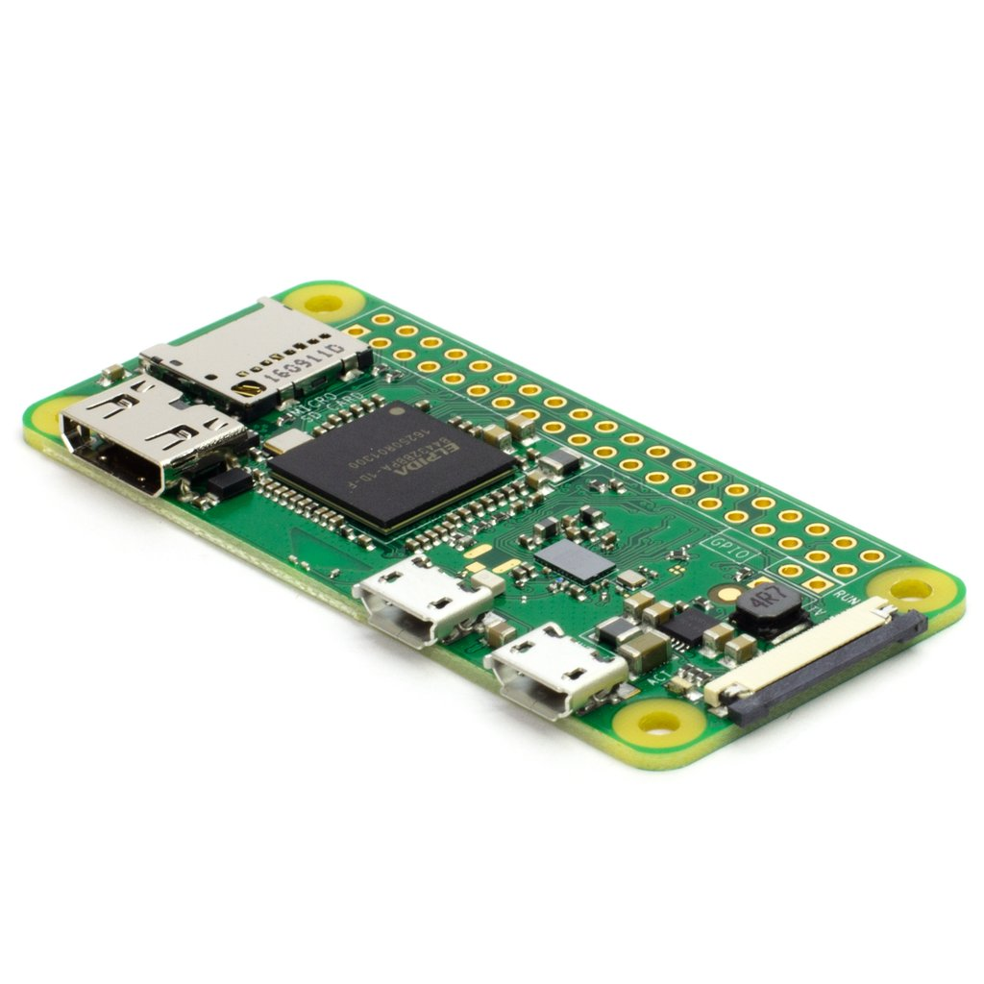
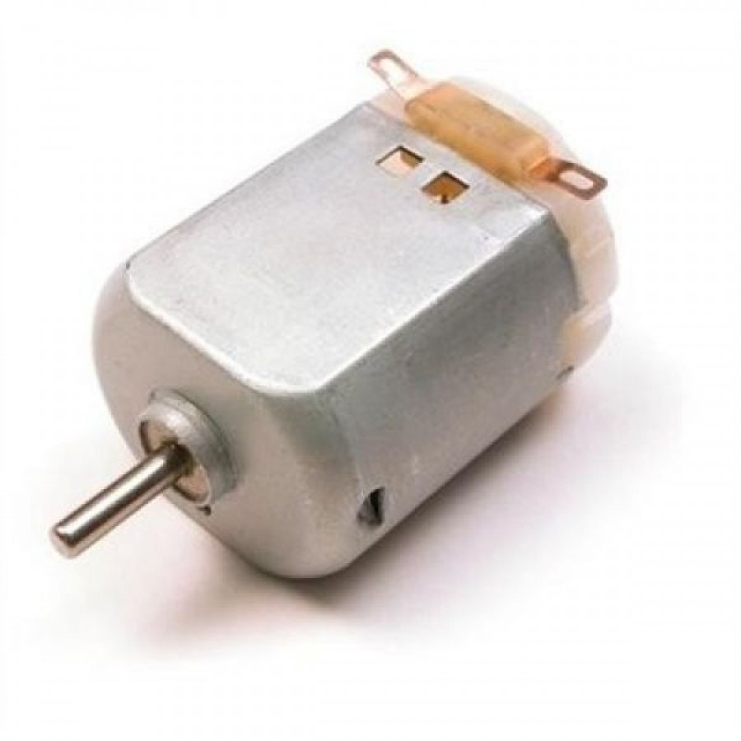
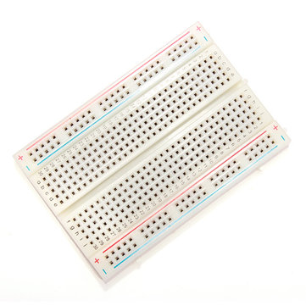
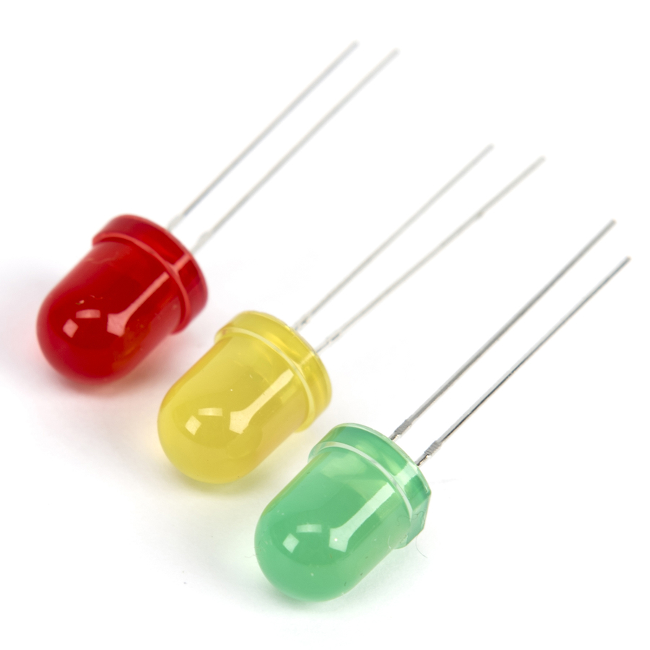
What we provide What you need to bring
A Kit containing…
Raspberry Pi Zero W
Breadboard & Jumper wires
Motors
LEDs, Resistors... and so on!
A Laptop
$21 fee
$10 deposit
$11 consumable parts of the robot

Slide 6
How the workshops will be run
A quick lecture ~20 - 30 min. in the beginning
Trottier 3120
Hands on time with people around to help
Trottier 5th floor study rooms

Slide 7
Today’s Task
Check that you have everything
Ohm’s Law
Understanding basic circuit diagram
Building a circuit based on schematics

Slide 8
Today’s Task
Check that you have everything
Breadboards x 1
Battery pack x 1
Box knife x 1
Jumper wires
USB to MicroUSB cable x 1
Resistors: 150𝞨 x 2, 100𝞨 x 5
Batteries x 4
Tri-color LEDs x 1
LEDs x 3 (yellow and green and red)
Switch x 1
Voltage regulator x 1

Slide 9
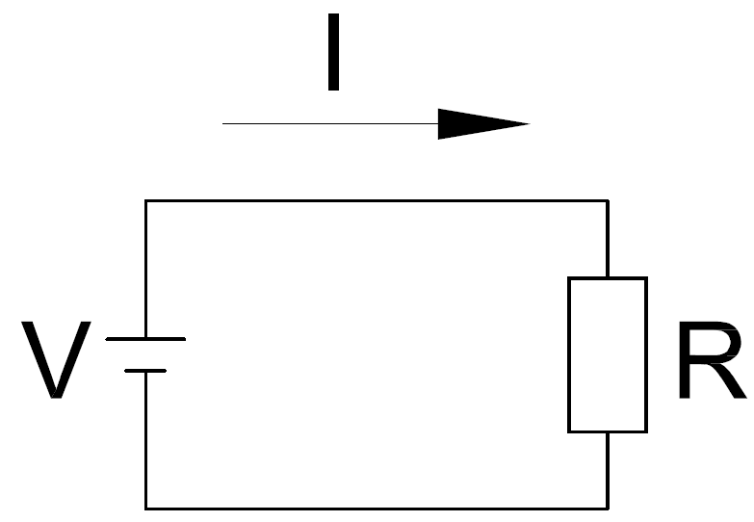
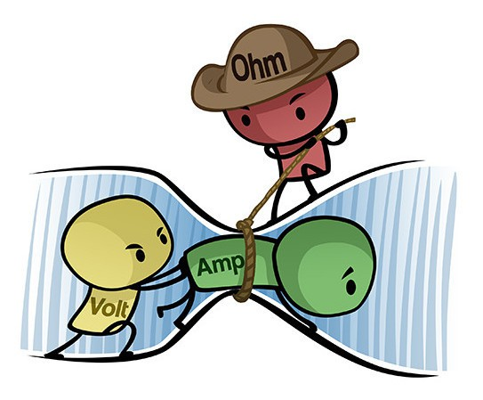
Ohm’s Law
3 variables
V = Voltage (volt), difference in electric pressure between two points
I = Current (amps), the flow of electric charge across a surface
R = Resistance (Ohm), all material have its own resistance
The electrical current flowing through a fixed linear resistance is directly proportional to the voltage applied across it, and also inversely proportional to the resistance.
I = V / R

Slide 10
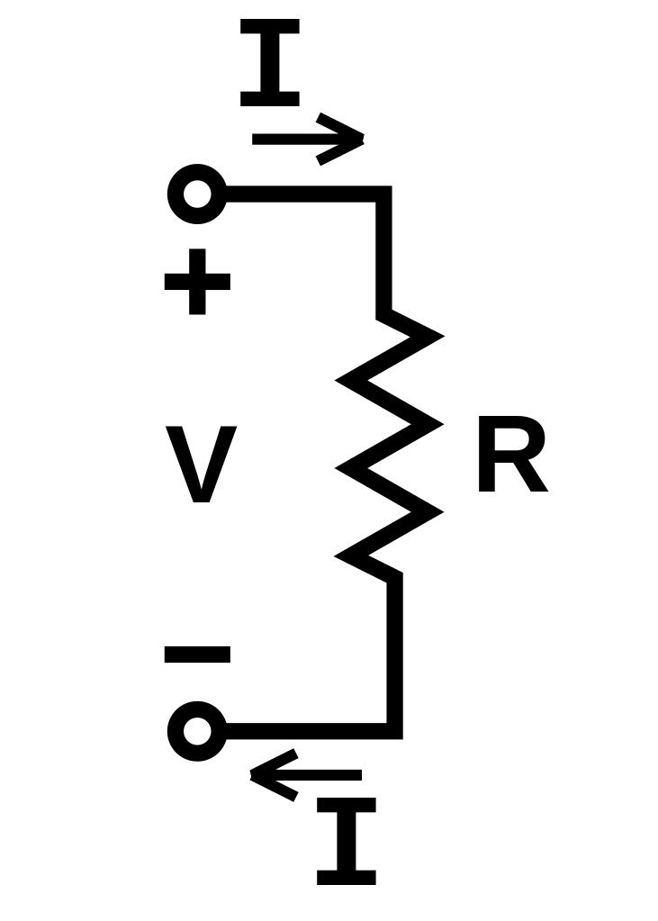
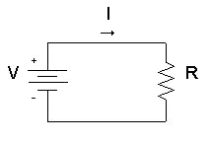
Understanding circuit symbols

Slide 11
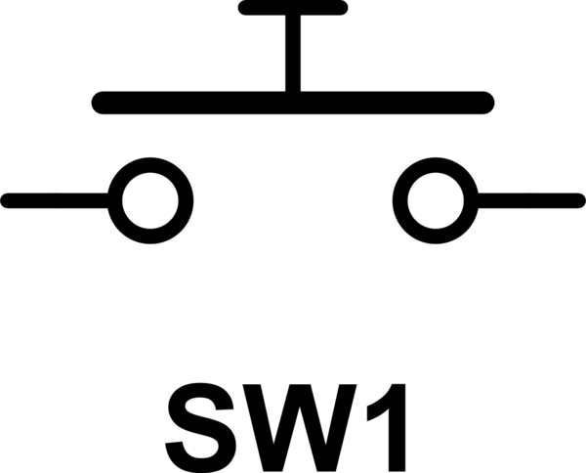

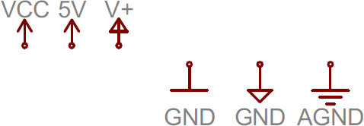
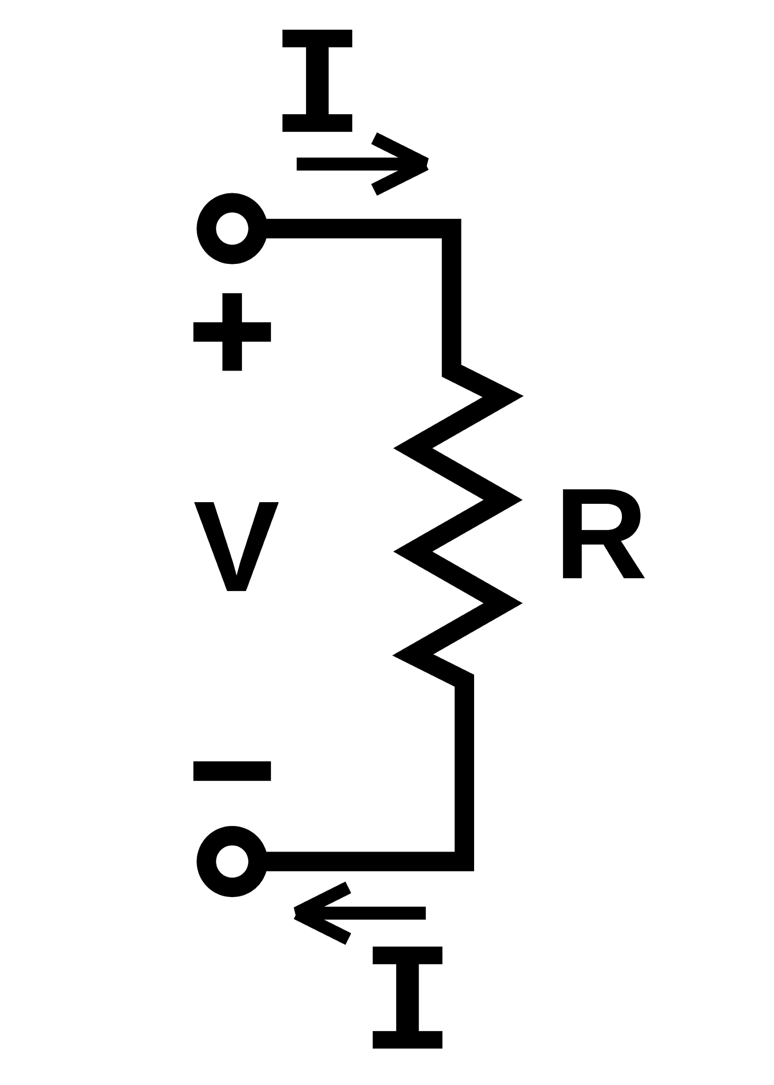
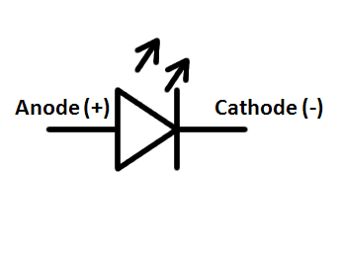

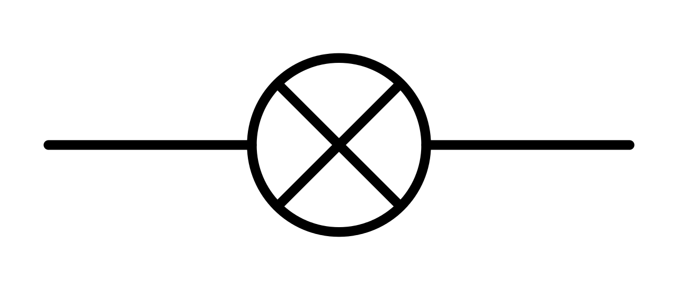
Other electronics symbols
Switches
Lamp
LED
Motor

Slide 12
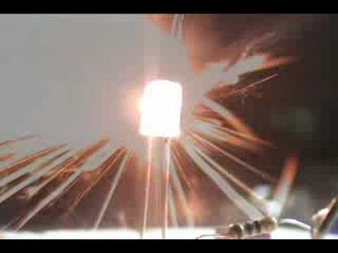
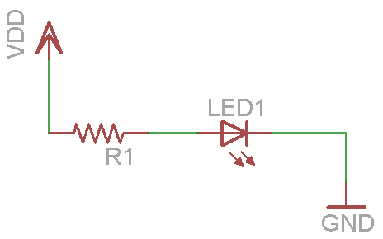
A LED circuit
Why do we need a resistor in the circuit?
Because LEDs have :
Forward voltage : Voltage need for the led to turn on (2-3V)
Operational current : 20mA, too much current can burn or explode the LED
The resistor is there to limit the current going through the LED

Slide 13
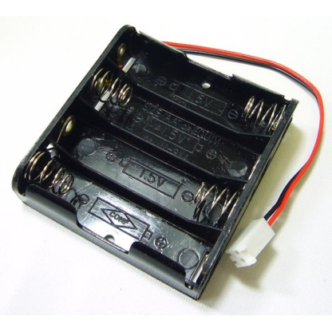
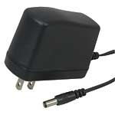
DC Power
All micro electronics run on DC power
Typical voltages
5V
3.3V
2.0V
Batteries can be used to supply the necessary voltage, but their voltage varies as a function of time
DC Transformers that plug into an AC outlet can also be used
Voltage regulators are used to ensure that devices get specific voltages
4 AA battery holder giving a total of 6V
A DC transformer that provides a fixed DC voltage from an AC outlet
‹#›

Slide 14
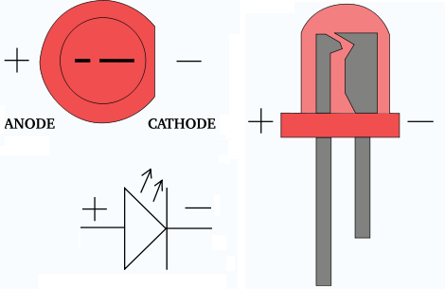
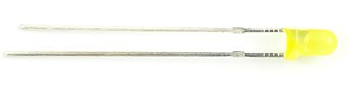
LED
LEDs, Light Emitting Diodes, are a common device found in most electronics
They are available in a wide variety of sizes and colours
LEDs have a specific amount of current and voltage that they can handle
Resistors are used to ensure that there is a fixed voltage drop across the LED
Usually around 2-3 V and 20 mA
A yellow LED, the shorter leg is the negative (-) connection

Slide 15
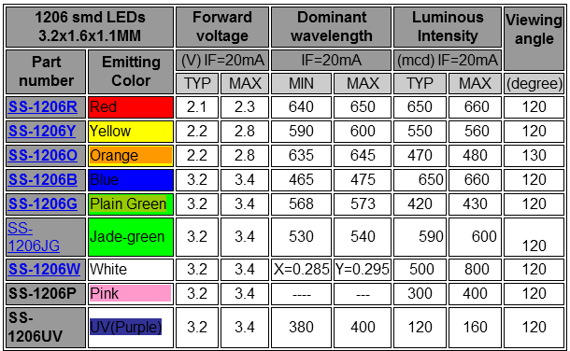
LED

Slide 16
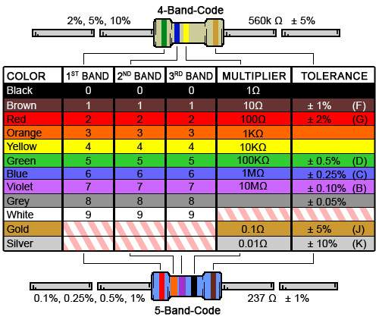
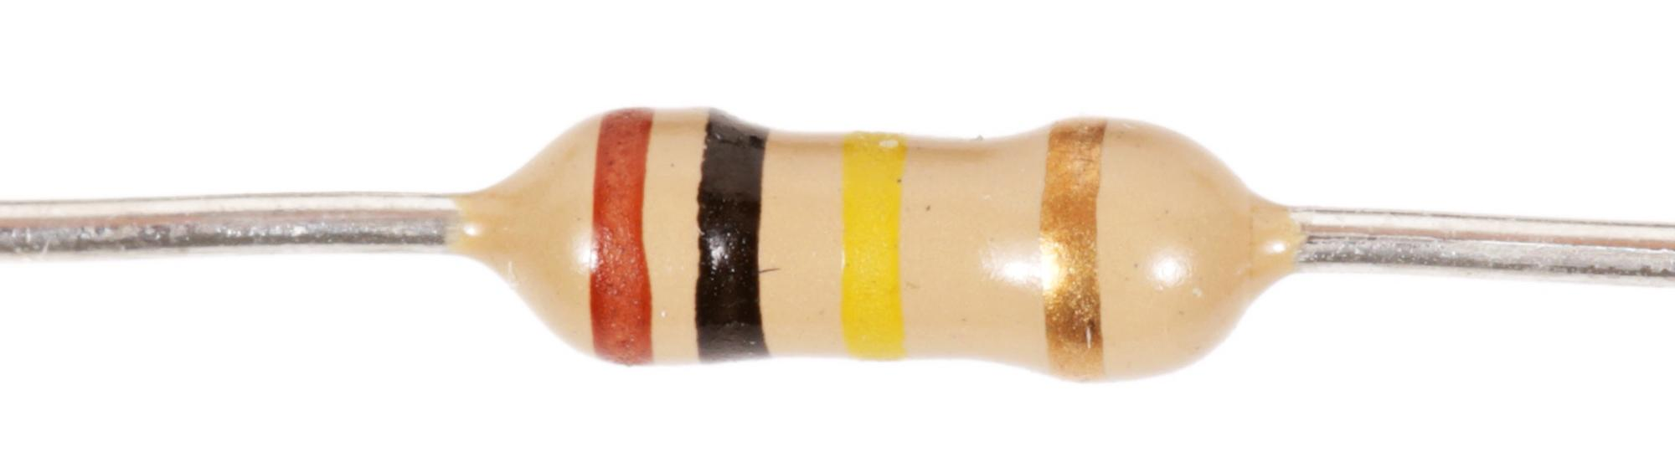
Resistors
The resistor values can be found with the color code chart
For 4-band resistors,
(1st Digit * 10 + 2nd Digit) * Multiplier
= (Brown: 1*10 + Black: 0) * Yellow: 10k𝞨
= 100k𝞨
Final band: Gold, Tolerance = ±5%

Slide 17
Choosing the appropriate resistor
The yellow LED has a typical forward current of 20 mA and a voltage drop of 2V
VDD is 5 volts
Find R1 such that the current through LED1 is 20 mA
V_{DD} = 5 V
1.V_{R} = V_{DD} - V_{LED}
V_{LED} = 2 V
2. i_{led} = i_{R1}
i_{led} = i_{R1}
i_{led} = 20 mA
Ohm’s Law (V = R * I)
3. V_{R} = R1 * i_{R1}
4. V_{DD} - V_{LED} = R1 * i_{R1}
V_{R} = V_{DD} - V_{LED}
5. (V_{DD} - V_{LED} )/ i_{R1} = R1
‹#›

Slide 18
Circuit diagrams to breadboards
The following circuit uses a battery to power a LED
VDD represents the positive terminal of the battery
R1 is a resistor to ensure that the voltage drop across the LED is fixed
LED1 is our light, not it has a positive and negative end
GND is the negative side of the battery
We can build this whole circuit on the breadboard
Positive
Negative
Node 3
Node 1
Node 2

Slide 19
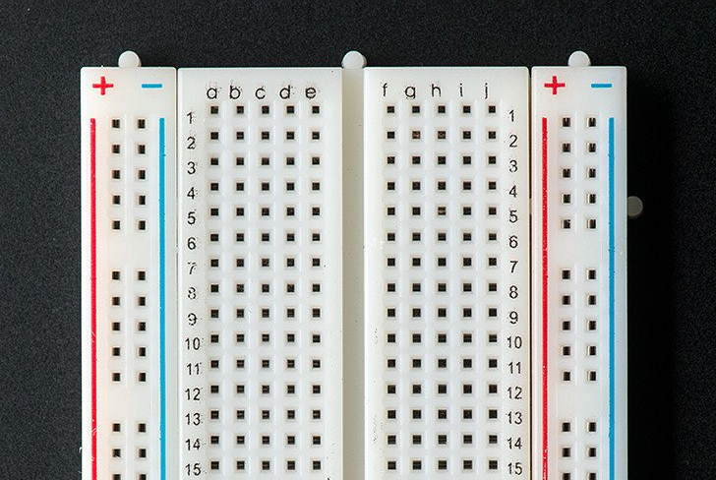
What is a Breadboard
Allow for prototyping - early sample/model of a product
You can place components such as LEDs, resistors, and chips in them
The pinhole inside the boxes are connected
Each row are connected itself (1,2,3, etc.) but not connected to each other
You can connect one row to another with components and wires
The divider in the middle separates the left side and the right side

Slide 20
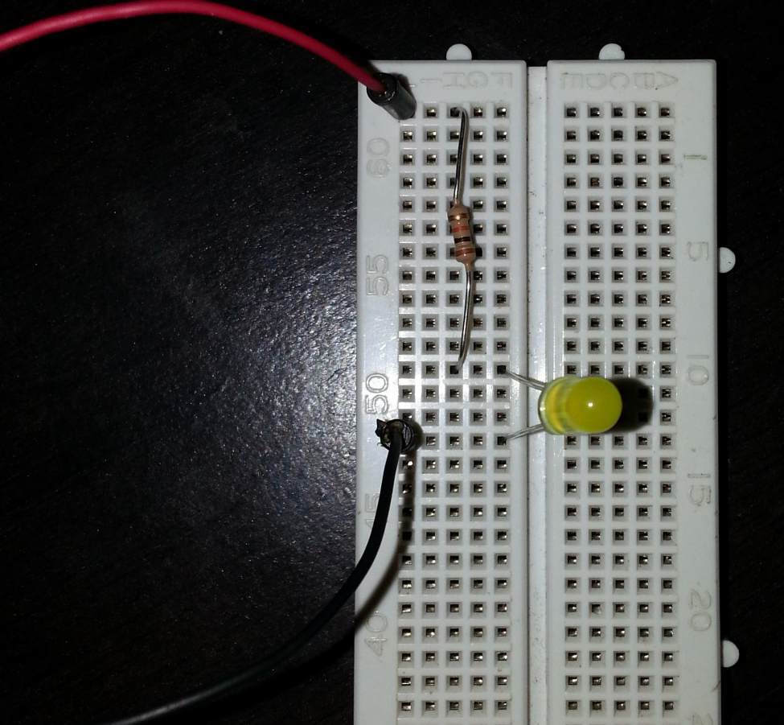
What this looks like on the breadboard
Positive
Negative
Node 3
Node 1
Node 1
Node 2
Each node in the circuit has a corresponding row on the board
The red wire is the positive supply of the battery connected to the resistor
The resistor is connected to the positive terminal of the LED
The LEDs negative terminal is connected to the ground of the battery, which is the black wire
Node 2
Node 3

Slide 21
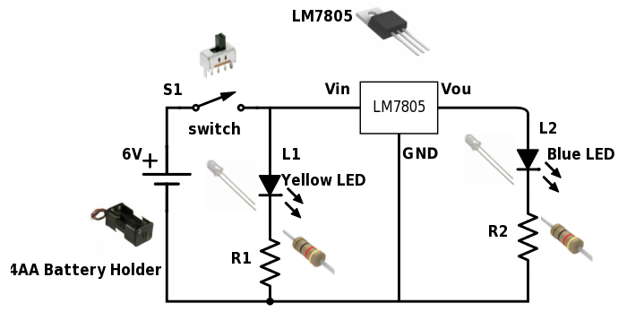
Voltage Regulator

Slide 22
The theory of voltage regulators
The voltage of our power supply, such as batteries, could be different from the required voltage of our chips
A 3.3V chip cannot sink 6 volts from four AA batteries
A Raspberry pi runs on 5V and can’t be run from a 9V battery
Instead a voltage regulator provides us with a steady fixed voltage to power all our chips
A secondary DC power supply in our circuit
Heat
Voltage Regulator
Vout
Vin
Vin > Vout

Slide 23
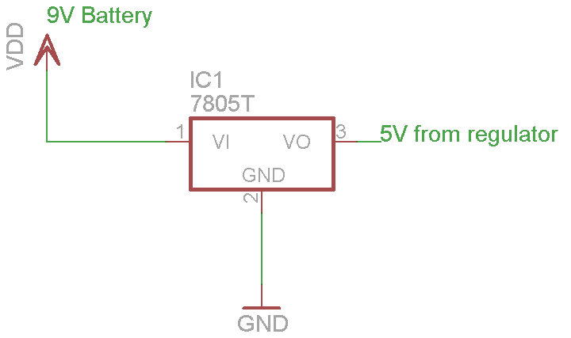
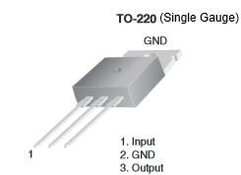
Voltage regulators in practice
Graphic showing the pin out of an LM7805 5V regulator in TO-220 package
A schematic of an LM7805 regulator connected to a 9V battery

Slide 24
A reminder of today’s task
Make sure you have all your parts and kit
Build a circuit to help you power your robot
Start working on your robot design
‹#›

